Slide 1

Analytics/Quantitative Methods: Summary & Revision
2021

Slide 2
Summary topics
Causal Relationships
Control variables
Endogeneity
Testing
Dummies
Instrumental Variables
Log transformations
Panel Data
Time Series

Slide 3
Focus on causal relationships
Not prediction…although we talked about that too..
e.g.
Outcome Variable
Dependent Variable
Y
What is the impact of marketing on sales?
X
Explanatory Variable
Independent Variable

Slide 4
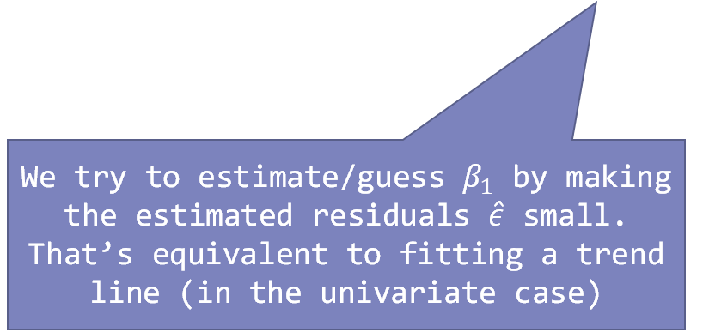
Formulas
$$Sales=β_{0}+β_{1}×Marketing+ε$$
Residual…also known as
Error term
Shock
Everything that’s not Marketing but affecting sales
We try to estimate/guess $β_{1}$ by making the estimated residuals $\hat{ε}$ small. That’s equivalent to fitting a trend line (in the univariate case)
$$Sales={\hat{β}}_{0}+{\hat{β}}_{1}×Marketing+\hat{ε}$$
use lm() command

Slide 5
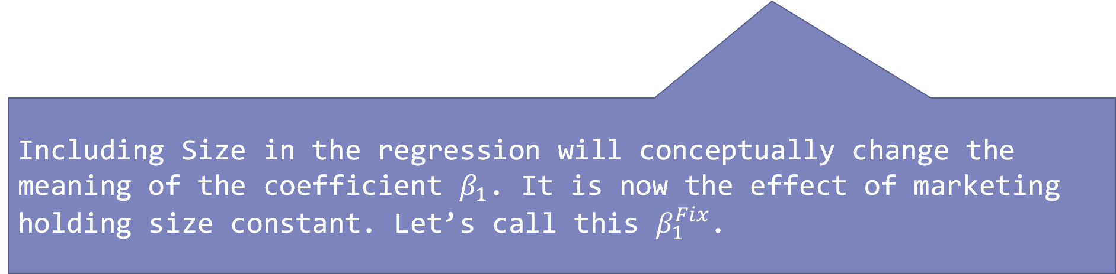

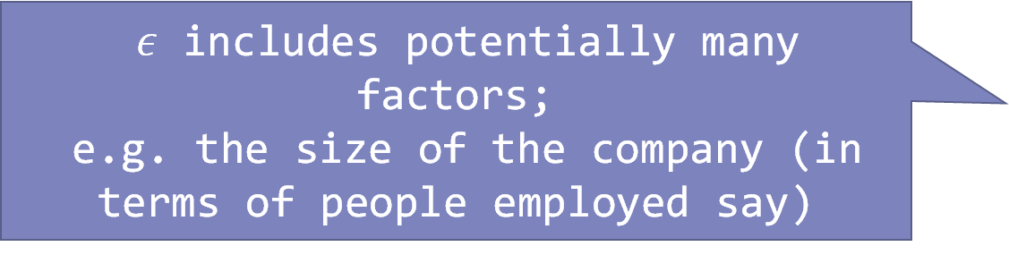
Other/Control variables
$$Sales=β_{0}+β_{1}×Marketing+ε$$
$ε$ includes potentially many factors;
e.g. the size of the company (in terms of people employed say)
$$ε=β_{2}Size+η$$
Including Size in the regression will conceptually change the meaning of the coefficient $β_{1}$. It is now the effect of marketing holding size constant. Let’s call this $β_{1}^{Fix}$.

Slide 6
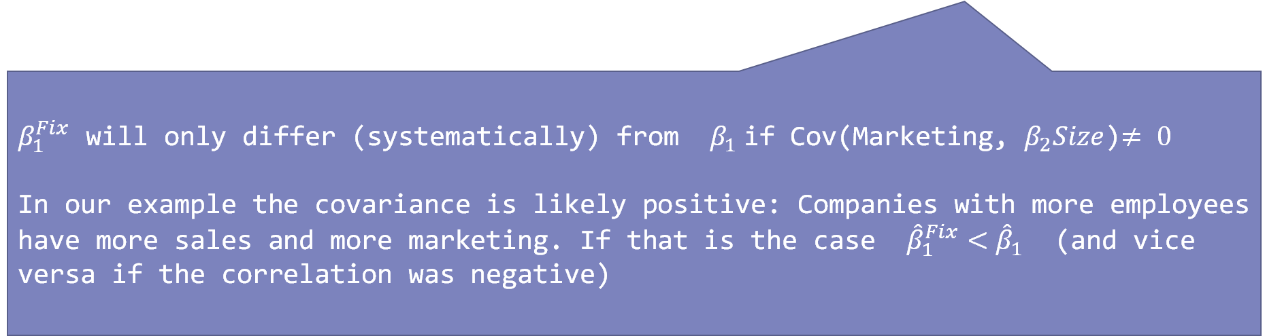

Other/Control variables
$$ε$$
$$Sales=β_{0}+β_{1}^{Fix}×Marketing+β_{2}Size+η$$
$β_{1}^{Fix}$ will only differ (systematically) from $β_{1}$if Cov(Marketing, $β_{2}Size$)$≠ 0$
In our example the covariance is likely positive: Companies with more employees have more sales and more marketing. If that is the case ${\hat{β}}_{1}^{Fix}<{\hat{β}}_{1}$ (and vice versa if the correlation was negative)

Slide 7
OLS will account for variation
Variation in Y
Variation in Y
Variation in X1
Variation in Xcontrol
Variation in X1
Variation in Xcontrol
…however only if X1 and Xcontrol are correlated
If we add in Xcontrol some of the variation in Y assigned to X1 will be assigned to Xcontrol

Slide 8
2 reasons why X1 and Xcontrol are correlated
Variation in Y
Variation in Y
Variation in X1
Variation in X1
Variation in Xcontrol
Variation in Xcontrol
X1 is driving Xcontrol
Xcontrol is driving X1
Taking away some of the variation assigned to X1 and assigning it to Xcontrol is a bad idea if Xcontrol is driven/caused by X1

Slide 9
For example: Marketing and Size (number of employees)
More money to spend on marketing overhead
Size
Marketing
More marketing will lead to more sales and more people employed (or indeed marketing staff)
Size
Marketing
Which scenario applies depends on your “datastory”. Maybe your data comes from an experiment where the marketing budget was randomly changed between observations (so we can rule out the first case)?

Slide 10
In practice?
Size
Marketing
In practice we might not be able to rule out either scenario. What to do?
Quick and dirty solution: see if including the control makes any difference to your conclusion about the impact of X1 (i.e. marketing in our example); i.e. report regression with and without Xcontrol. If you are lucky conclusions don’t change much
If they do: caveat your results. Ask for further research; e.g. RCT or finding instrument:
Something that changes marketing but not size (or other factors in residual);
For example: maybe some firms/observations in your data were subject to restrictions on advertising (e.g. rules on cigarettes/gambling advertisements)

Slide 11


Endogeneity
If elements of $ε$ (e.g. size) drive our X variables (or instruments in the IV case) then we suffer from endogeneity
i.e. our estimated parameter is systematically too low or too high
The consequence is bias
Upward: Estimated parameter is systematically larger than true
$$E\left\{\hat{β}\right\}>β$$
Downward: Estimate parameter is systematically smaller than true
$$E\left\{\hat{β}\right\}<β$$

Slide 12
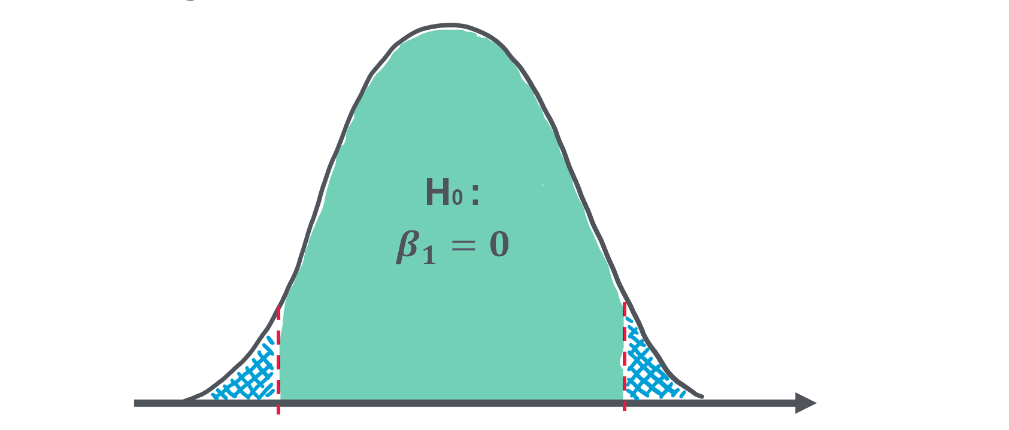

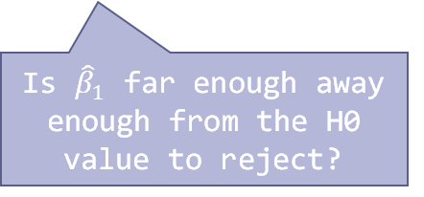

Testing
$${\hat{β}}_{1}$$
Is ${\hat{β}}_{1}$ far enough away enough from the H0 value to reject?
Estimating parameters is a risky businesses; i.e. there is uncertainty
Luckily we can describe this uncertainty in most cases with a variance and a probability distribution under a specific hypothesis
E.g. the hypothesis (H0) that a parameter is 0.
We showed that if this is the case the OLS estimate of this parameter would have a bell shaped probability distribution centred at 0
We can then work out how likely a given estimate $\hat{β}$ is (p-value). The further away from 0 the parameter is the more unlikely.
We can define a significance level and critical value. If $\hat{β}$ is further away than the critical value or less likely than the significance level we reject the H0

Slide 13
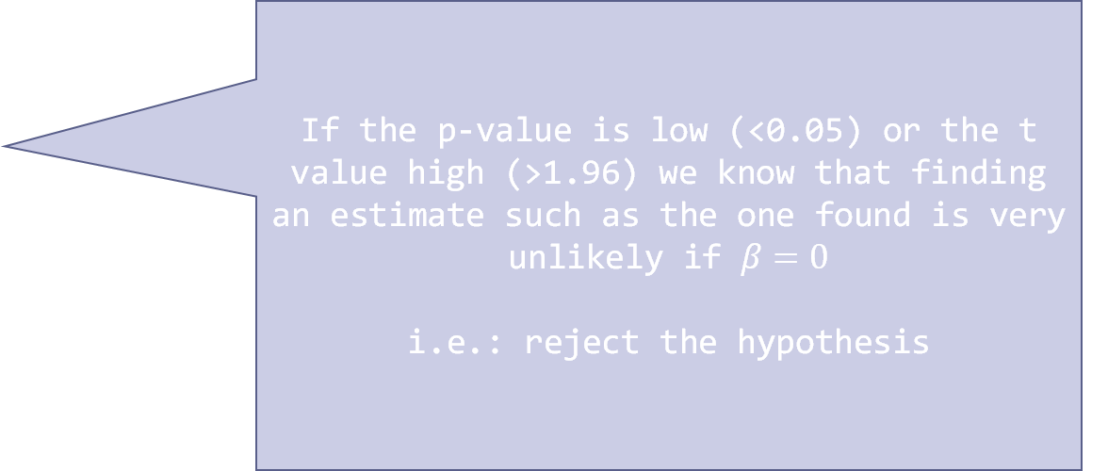
Routine testing of H0: β=0
## lm(formula = crimesPc ~ b_migr11 + pop11 + urate2011 + medianage, ## data = df) ## ## Residuals: ## Min 1Q Median 3Q Max ## -0.8873 -0.2680 -0.0783 0.1434 3.1754 ## ## Coefficients: ## Estimate Std. Error t value Pr(>|t|) ## (Intercept) 3.689e+00 4.855e-01 7.599 3.57e-13 *** ## b_migr11 5.446e-03 3.879e-03 1.404 0.16130 ## pop11 -8.656e-07 2.793e-07 -3.099 0.00212 ** ## urate2011 4.016e-02 9.320e-03 4.309 2.20e-05 *** ## medianage -6.305e-02 1.027e-02 -6.138 2.55e-09 *** ## --- ## Signif. codes: 0 '***' 0.001 '**' 0.01 '*' 0.05 '.' 0.1 ' ' 1 ## ## Residual standard error: 0.4774 on 310 degrees of freedom ## (105 observations deleted due to missingness) ## Multiple R-squared: 0.3468, Adjusted R-squared: 0.3383
If the p-value is low (<0.05) or the t value high (>1.96) we know that finding an estimate such as the one found is very unlikely if $β=0$
i.e.: reject the hypothesis

Slide 14
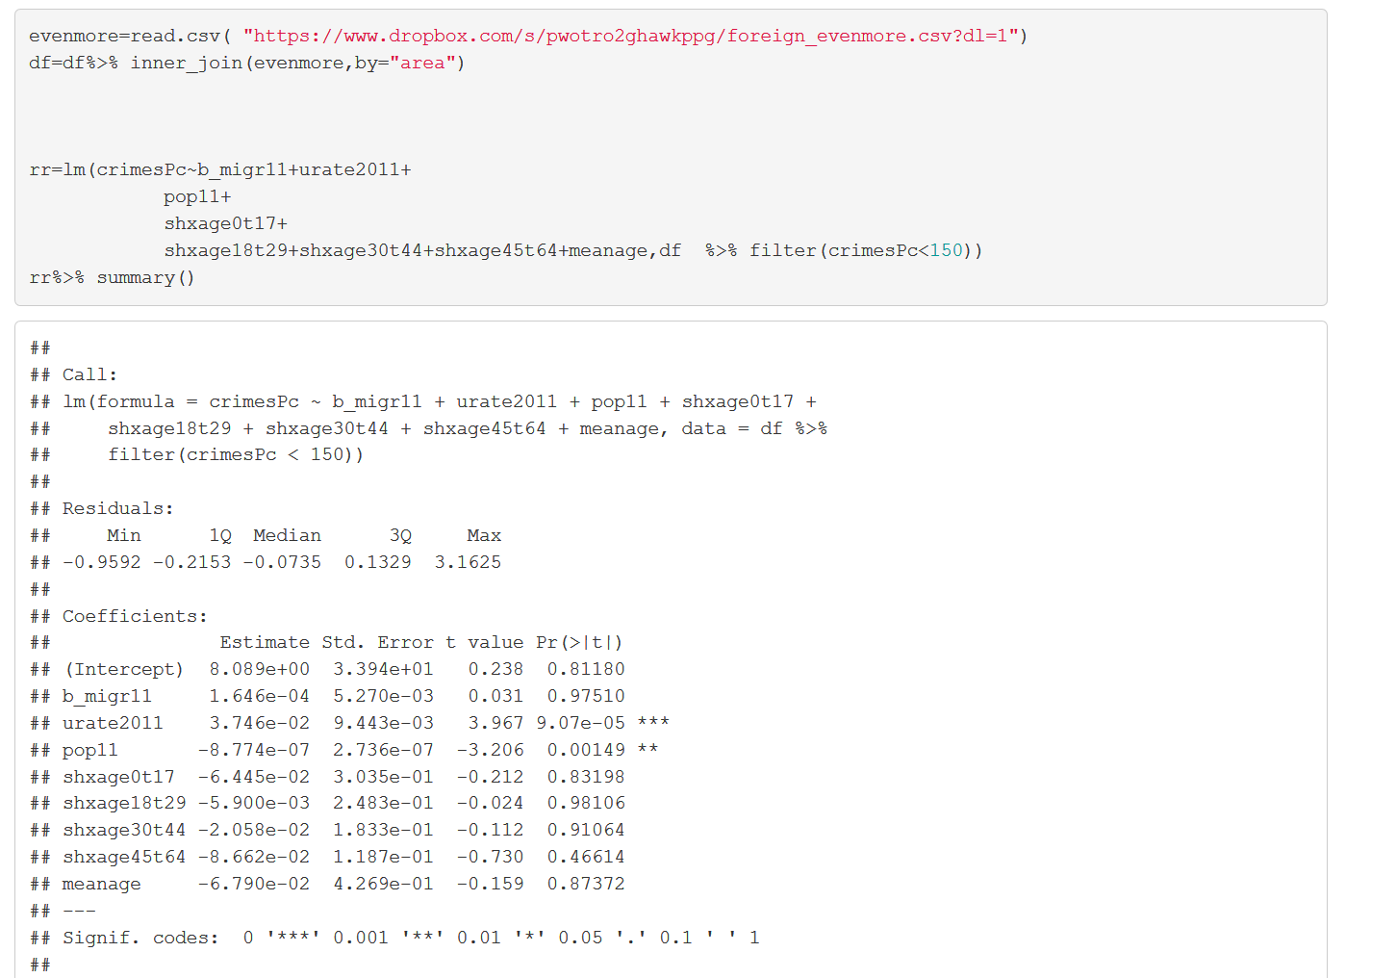
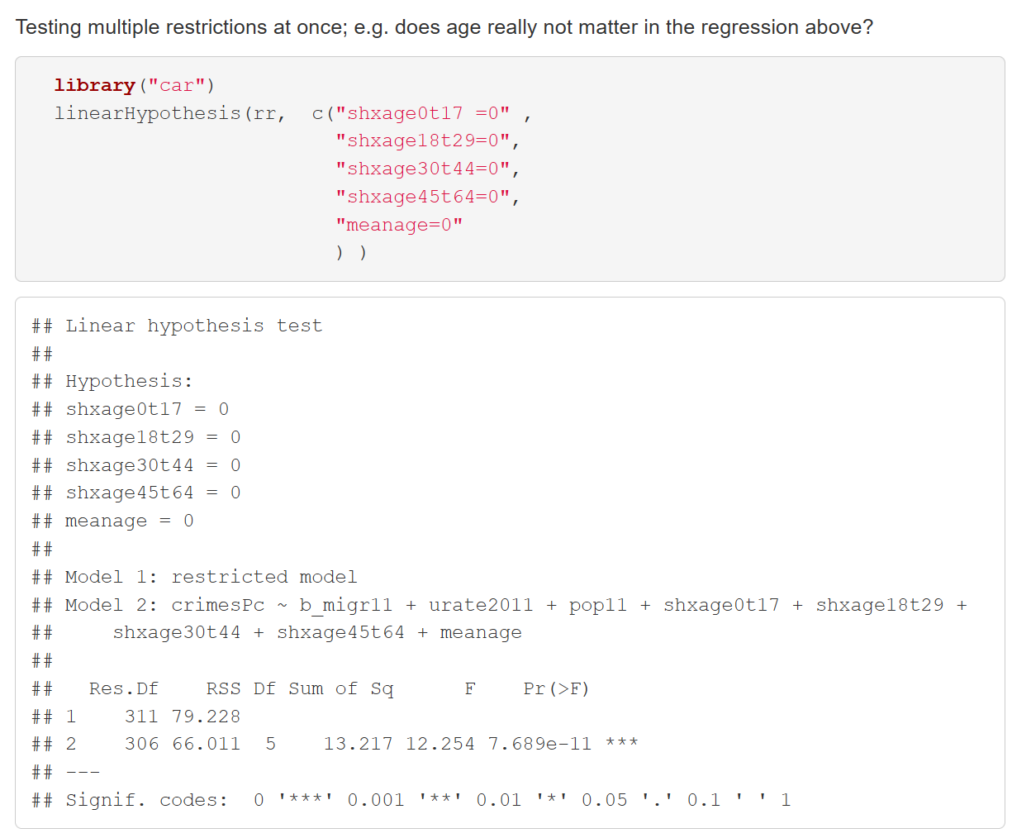
Ftesting
More Boutique kind of testing….
Use linearHypothesis() command in package car
e.g. we can test that several parameters are equal to 0

Slide 15


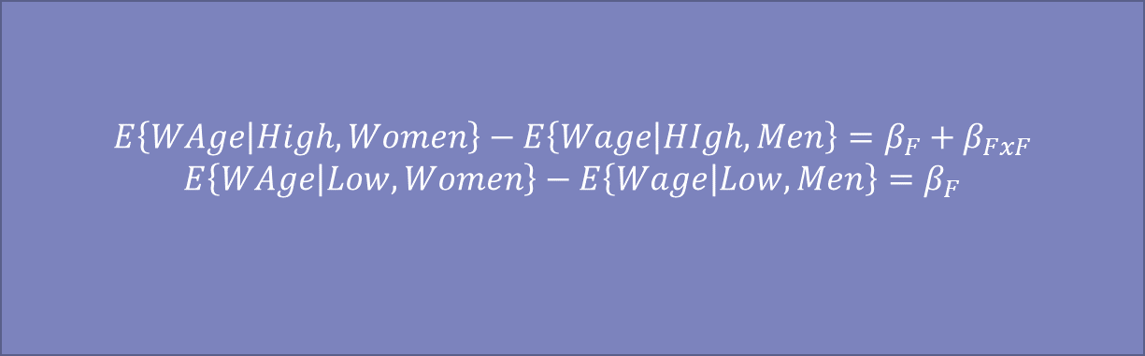
Dummy variables
We can group the observations in our dataset; e.g.
Gender
Country
Types of education
Time periods
We can include binary/dummy variables indicating those categories as explanatory variables
We can represent what we can expect about the dependent variable given those categories in terms of the parameters associated with those variables; e.g.
$$Y=β_{1}x+β_{2}x^{2}$$
$$β_{1}+2β_{2}x$$
$$E\left\{WAge | High,Women\right\}−E\left\{Wage | HIgh, Men\right\}=β_{F}+β_{FxF}$$
$$E\left\{WAge | Low,Women\right\}−E\left\{Wage | Low, Men\right\}=β_{F}$$
$$Wage=β_{C}+β_{F}FEMALE+β_{H}HighSkill+β_{H×F}HighSkill×FEMALE+ε$$
e.g. which wage do we expect for a high skilled women?
$$E\left\{Wage | High Skilled Women\right\}=β_{c}+β_{F}+β_{H}+β_{H×F}$$

Slide 16
An elaborate and creative example of using dummies: Differences in Differences and the EU ETS
AKA Exercise 10.2
In 2013 the European Emissions Trading System (EUETS) became more stringent. A smaller number of permits were allocated freely to companies.
However, this varied across firms: more energy intensive and/or trade intensive firms continued to get free permits
Did this have any impact on carbon emission by those firms?
If we have panel data on emissions for those firms from before and after the regulatory change, we can use dummies to group our observations in 4 categories
Time Period
Pre 2013 observations from firms who receive free permits throughout | 2013 onwards observations from firms receiving free permits
Pre 2013 observations from firms who in 2013 no longer get free permits | 2013 onwards observations from firms who in 2013 no longer get free permits
Firm Type

Slide 17
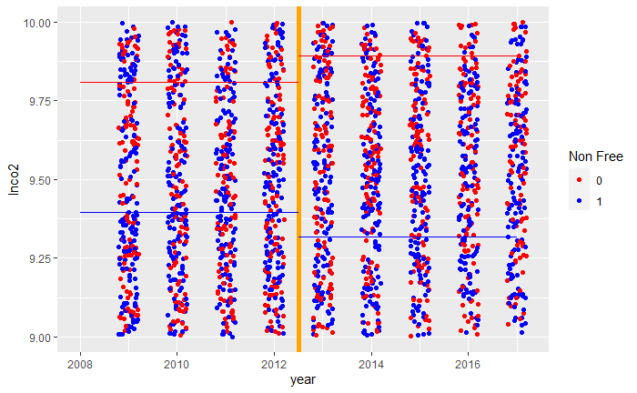
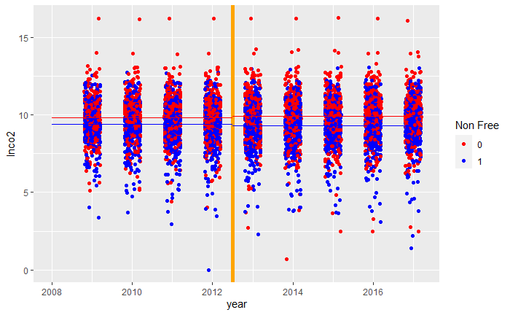
We can look at a scatterplot
zooooom
Average CO2 consumption for 2013 onwards observations from firms who get free permits throughout
Average CO2 consumption for pre 2013 observations from firms who get free permits throughout
Red group receive free permits throughout…
Mind the widening gap!
Average CO2 consumption for pre 2013 observations from firms who in 2013 no longer get free permits
Average CO2 consumption for 2013 onwards observations from firms who in 2013 no longer get free permits
We measure the impact of not giving free permits by how much the gap between both groups of firms changed (widened) after 2013

Slide 18

Differences in differences model: 2 sets of dummies
$$\ln{CO2}=β_{c}+β_{post}2013onwards+β_{nf}NonFree+β_{×}2013onwards×NonFree+ε$$
Gap before 2013:
$$E\left\{\ln{CO2} | pre2013,nonfree\right\}−E\left\{\ln{CO2} | pre2013,free\right\}=β_{nf}$$
Gap 2013 onwards:
$$E\left\{\ln{CO2} | 2013onwrds,nonfree\right\}−E\left\{\ln{CO2} | 2013onwrds,free\right\}=β_{nf}+β_{×}$$
Change in Gap: $β_{X}$
To understand the impact of non free allocation on emissions it suffices to look at the interaction term

Slide 19
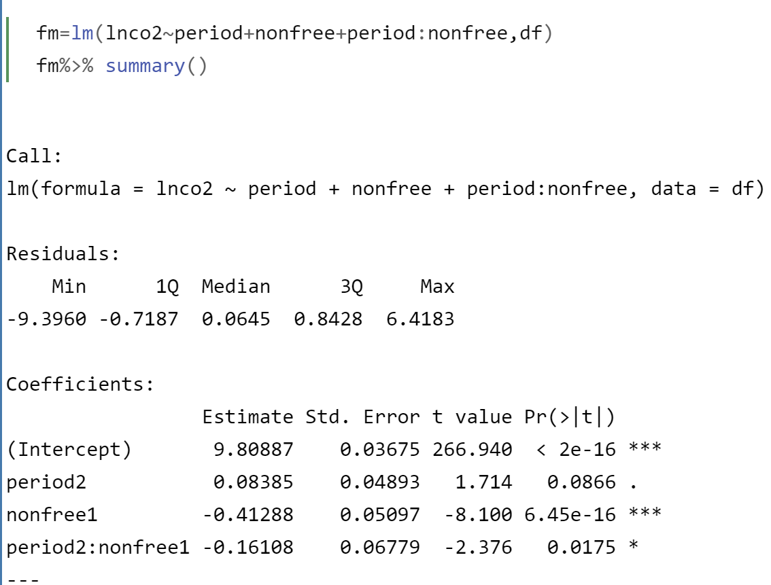
DiD in Action
Free allocation firms increased their emissions from 2013 by 8% on average
Non Free group has lower carbon emissions even before 2013
The gap widened by 16%

Slide 20
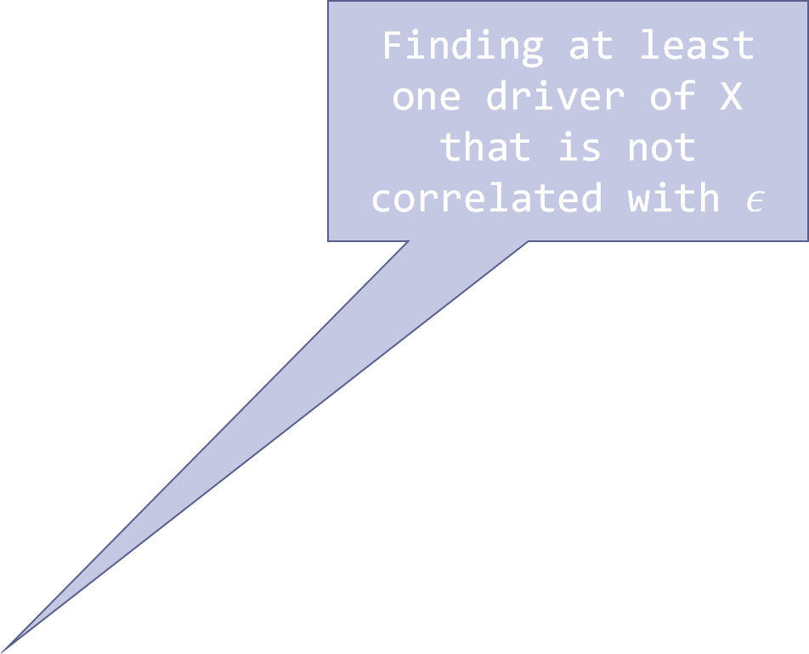


Instrumental Variables
Finding at least one driver of X that is not correlated with $ε$
$$Y=Xβ+ϵ$$
Criterion 2
Criterion 3
Criterion 1
$$Z$$

Slide 21

IV example: Cigarette demand curve (Ex 10.9)
$$\log\left(Packs\right)=β_{0}+β_{1}×\log\left(Price\right)+ε$$
Data for US states 1985, 1995
Negative demand elasticity.
However, there could be upward bias: demand shock could be driving the price

Slide 22

IV example: Cigarette demand curve (Ex 10.9)
$$\log\left(Packs\right)=β_{0}+β_{1}×\log\left(Price\right)+ε$$
We need a driver of Price that is not affected by demand shocks nor has a separate influence on demand apart from the effect on price.
Idea: Taxes on cigarettes
Pro: Plausible that key drivers of policy on tax are un-related to cigarette demand; e.g. need to raise government revenue, political ideology, concern for health.
Con:
Taxes could be driven by demand; e.g. the disastrous health because of passion for cigarettes puts pressure on health system. (i.e. criteria 1 violated)
Taxes could also be just one part of a wider policy package. In addition the government might run a campaign warning of the health damage of smoking. (violation of criterion 3)
We also need to check if criterion 2 is met; i.e. tax is driver of price; This could be violated if due to competition (e.g. via smuggled cigarettes) producers might not pass on the tax on price. But it’s something we can check.

Slide 23
Demand, prices & taxes
Violation of criterion 1
Pressure on Health system triggers policy action
Cigarette Demand
Price
Other policies
(e.g. anti smoking ad campaign)
Tax
Violation of criterion 3

Slide 24
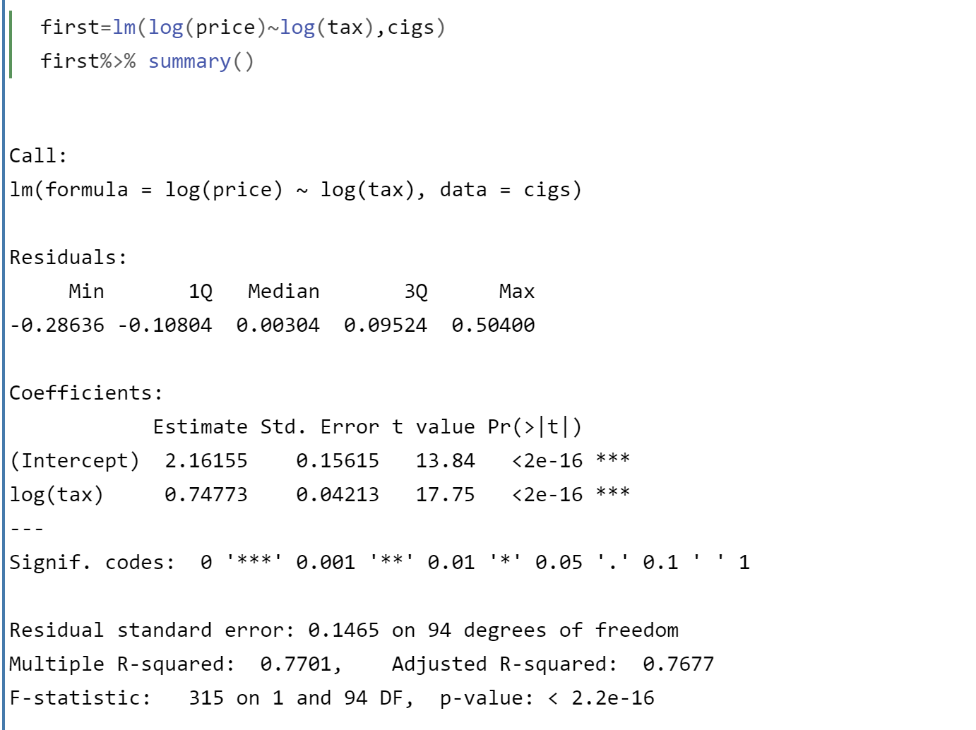
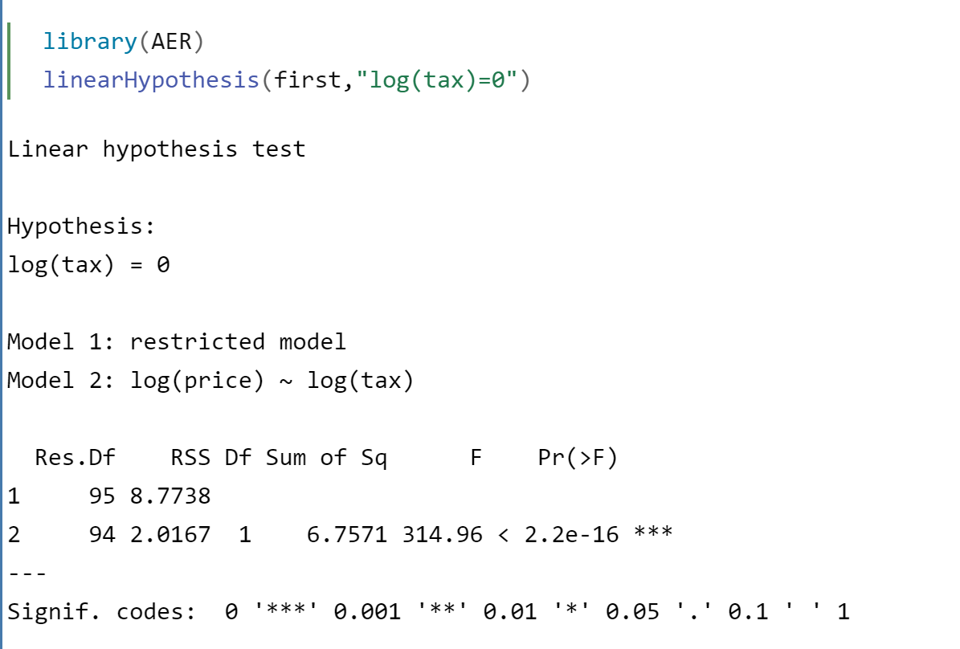
First stage regression
We see that tax is a strong driver of price: F-test>10
Without further control variables the routine F-test shown is equivalent to Ftest on instrument not having an effect on explanatory variable

Slide 25
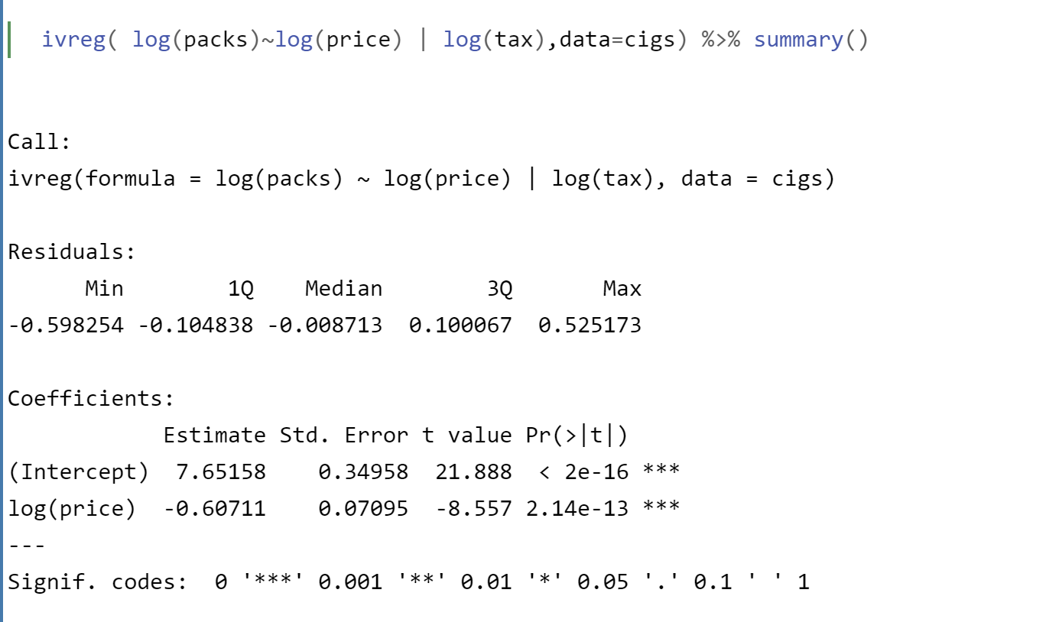
2nd stage IV regression
Price elasticity now higher;
i.e. we had upward bias before

Slide 26

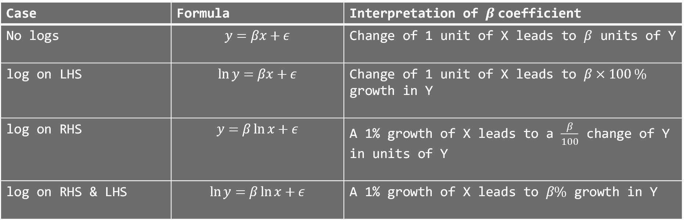
log log
Case | Formula | Interpretation of $β$coefficient
No logs | $$y=βx+ε$$ | Change of 1 unit of X leads to $β$ units of Y
log on LHS | $$\ln{y}=βx+ε$$ | Change of 1 unit of X leads to $β×100 \%$ growth in Y
log on RHS | $$y=β\ln{x}+ε$$ | A 1% growth of X leads to a $\frac{β}{100}$ change of Y in units of Y
log on RHS & LHS | $$\ln{y}=β\ln{x}+ε$$ | A 1% growth of X leads to $β\%$ growth in Y

Slide 27


log log explanation
$ΔXβ$ represents change $ΔY=Y_{1}−Y_{0}$ if we start at point $X_{0}$ and then move to $X_{1}=X_{0}+ΔX$
Hence $β$ is the change $ΔY$ for $ΔX=1$
If $Y=\ln{\tilde{Y}}$ then $ΔY≈\frac{Δ\tilde{Y}}{{\tilde{Y}}_{0}}$ so $β×100$is growth rate in % due to $ΔX=1$
If $X=\ln{\tilde{X}}$ and $\tilde{X}$ grows by 1%, then $ΔX≈0.01$ → $ΔY=β×0.01$
If $Y=\ln{\tilde{Y}}$ then $β×0.01×100=β$ is the (approximate) growth in % of $\tilde{Y}$ due to $\tilde{X}$ growing by 1%
This is also known as elasticity

Slide 28
Panel data
(e.g. data from Exercise6.2)
An opportunity to have a lot of dummy variables
Helps to control for time or cross sectional confounding factors that are fixed within a time period or cross sectional unit
Data on 146 firms (from Chile) over the years from 79 to 86
Value added (va), labour(l), capital (k), material (m)
Opportunity to estimate Cobb-Douglas Production Functions
$\log\left(VA\right)=α_{L}\log\left(L\right)+α_{K}\log\left(K\right)+ε$

Slide 29
Estimation of the Cobb-Douglas Production Function
A 1% increase in labour leads to a 0.94% increase in output

Slide 30
Production function estimation
In boom times firms will sell more at higher price (VA up). They might have an easier time financing a capital increase. We can use time dummies (i.e. time fixed effects) to control for that.
$\log\left(VA\right)=α_{L}\log\left(L\right)+α_{K}\log\left(K\right)+ε$
Firms with better management employ more people and have more capital. If management quality is stable over time we can use firm dummies(i.e. firm fixed effects) to control for that

Slide 31
Estimation with fixed effects
A 1% increase in labour leads to a 0.70% increase in output

Slide 32
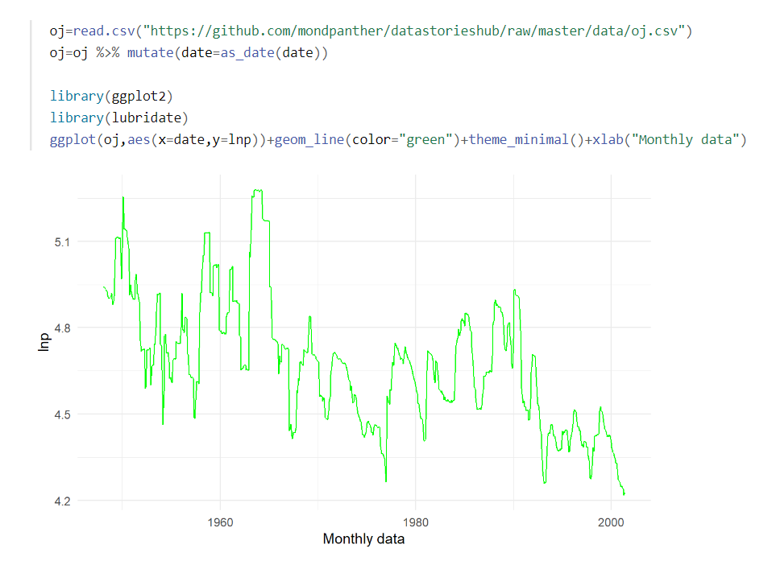

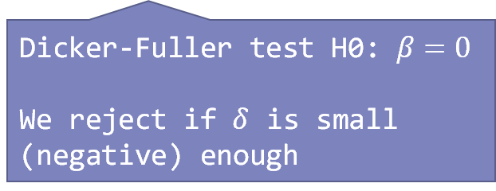

Time Series
Datapoints are different time period
Issues:
Time can be become confounding variable
Too much correlation between different observations
$$Y_{t}=ρY_{t−1}+ε_{t}$$
Hence before we can do causal inference, we need to check that $Y_{t}$ is stationary
$$Y_{t}=ρY_{t−1}+ε_{t}$$
⇓
$$Y_{t}−Y_{t−1}=ΔY_{t}=\underset{=δ}{\underbrace{\left(ρ−1\right)}}Y_{t−1}+ε_{t}$$
Dicker-Fuller test H0: $β=0$
We reject if $δ$ is small (negative) enough

Slide 33
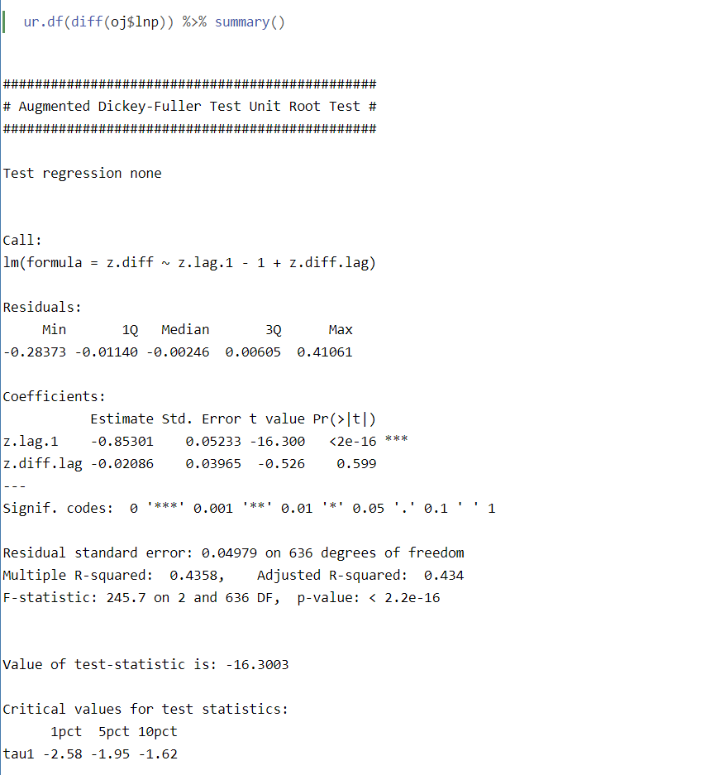
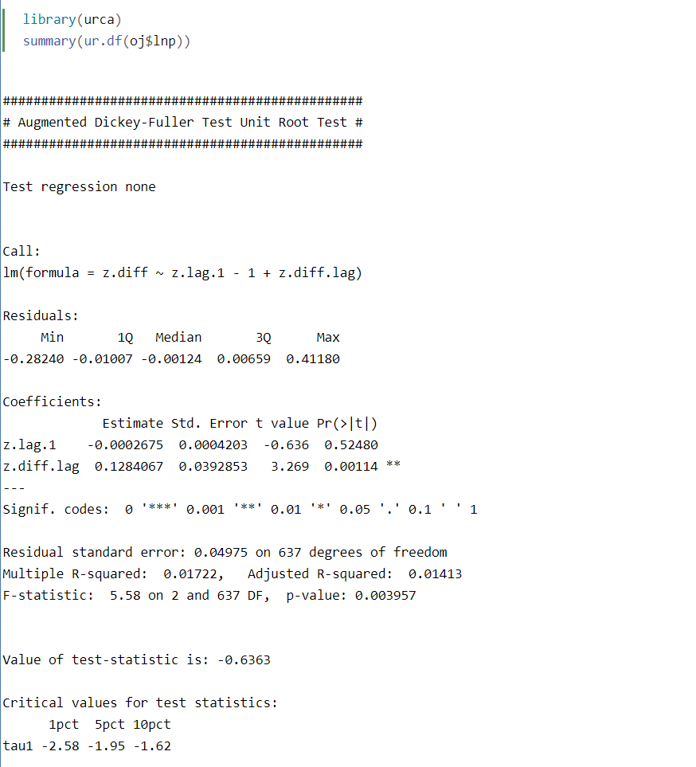
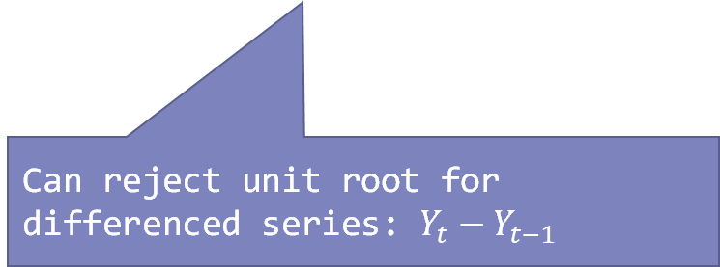
Dickey Fuller Test
Can reject unit root for differenced series: $Y_{t}−Y_{t−1}$
Cannot reject unit root: -0.6>-1.95

Slide 34
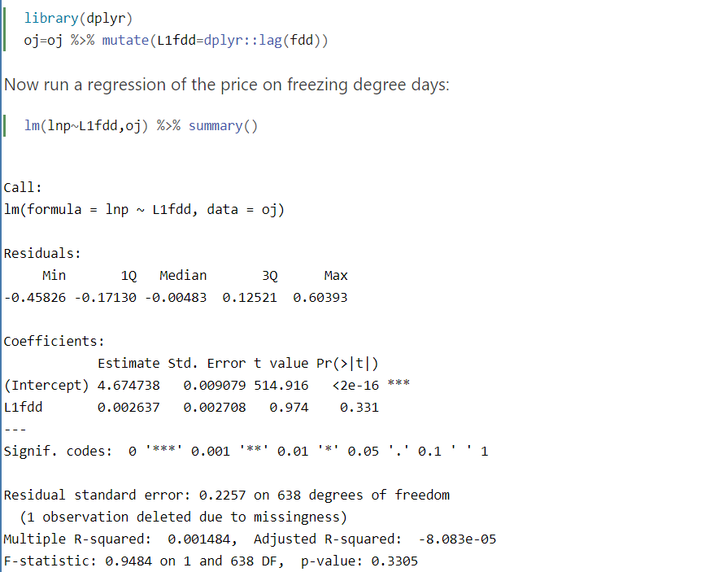
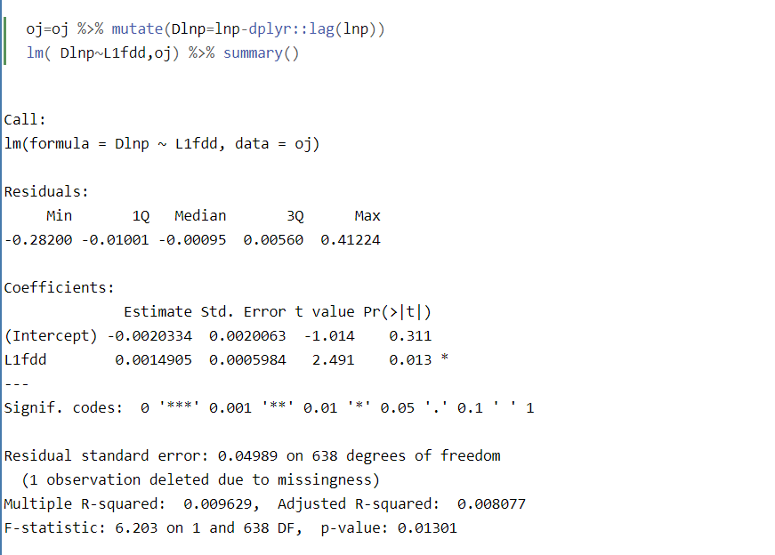
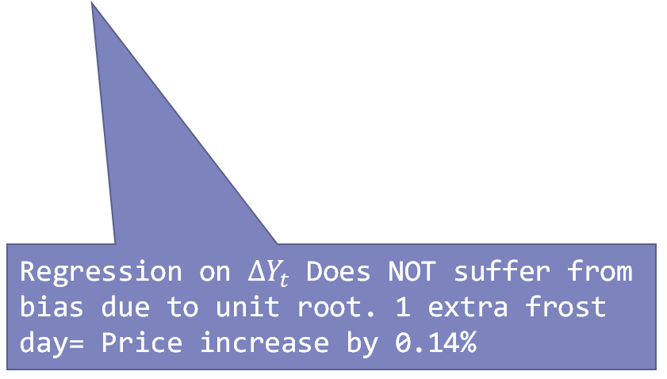
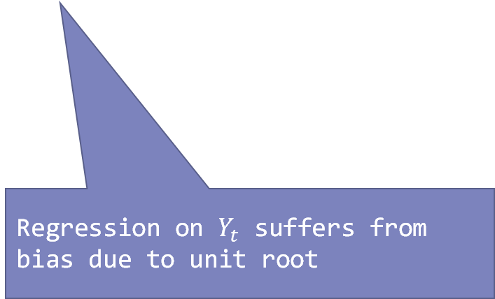
Causal Inference with Time series
Number of frost days in a month
Regression on $Y_{t}$ suffers from bias due to unit root
Regression on $ΔY_{t}$ Does NOT suffer from bias due to unit root. 1 extra frost day= Price increase by 0.14%

Slide 35

Extra Slides

Slide 36
To control or not control?
$$ε$$
$$Sales=β_{0}+β_{1}^{Fix}×Marketing+β_{2}Size+η$$
Is it always a good idea to include a control such as Size if we are primarily interested in the causal effect of more marketing?
Depends on the direction of the causality driving the correlation between size and marketing.

Slide 37
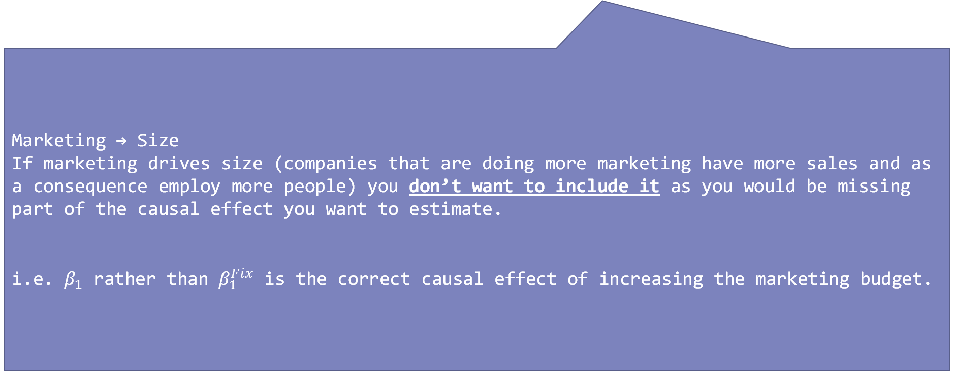
To control or not control?
$$ε$$
$$Sales=β_{0}+β_{1}^{Fix}×Marketing+β_{2}Size+η$$
Marketing → Size
If marketing drives size (companies that are doing more marketing have more sales and as a consequence employ more people) you don’t want to include it as you would be missing part of the causal effect you want to estimate.
i.e. $β_{1}$ rather than $β_{1}^{Fix}$ is the correct causal effect of increasing the marketing budget.

Slide 38
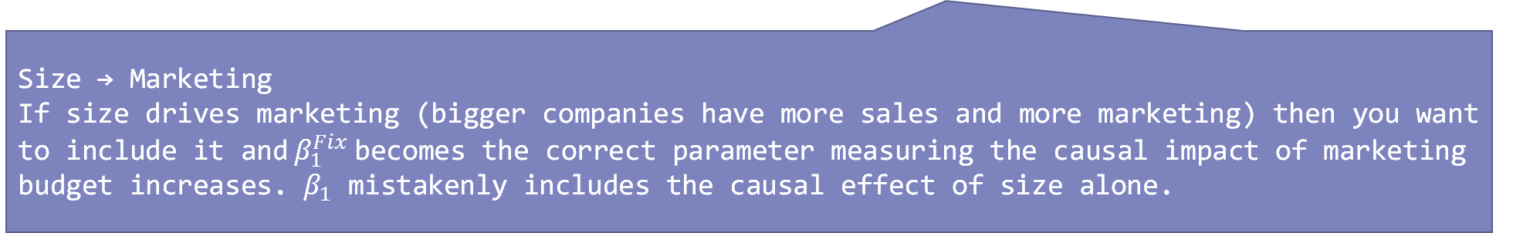
To control or not control?
$$ε$$
$$Sales=β_{0}+β_{1}^{Fix}×Marketing+β_{2}Size+η$$
Size → Marketing
If size drives marketing (bigger companies have more sales and more marketing) then you want to include it and$β_{1}^{Fix}$becomes the correct parameter measuring the causal impact of marketing budget increases. $β_{1}$ mistakenly includes the causal effect of size alone.
Which of those is the case depends on where the data and variation in the data comes from (i.e. the data story). Is it data from a study where firms randomly varied their marketing budget? Maybe the data comes from a sample of profit centres within a firm that had discretion over their marketing budget but not their team size?

Slide 39
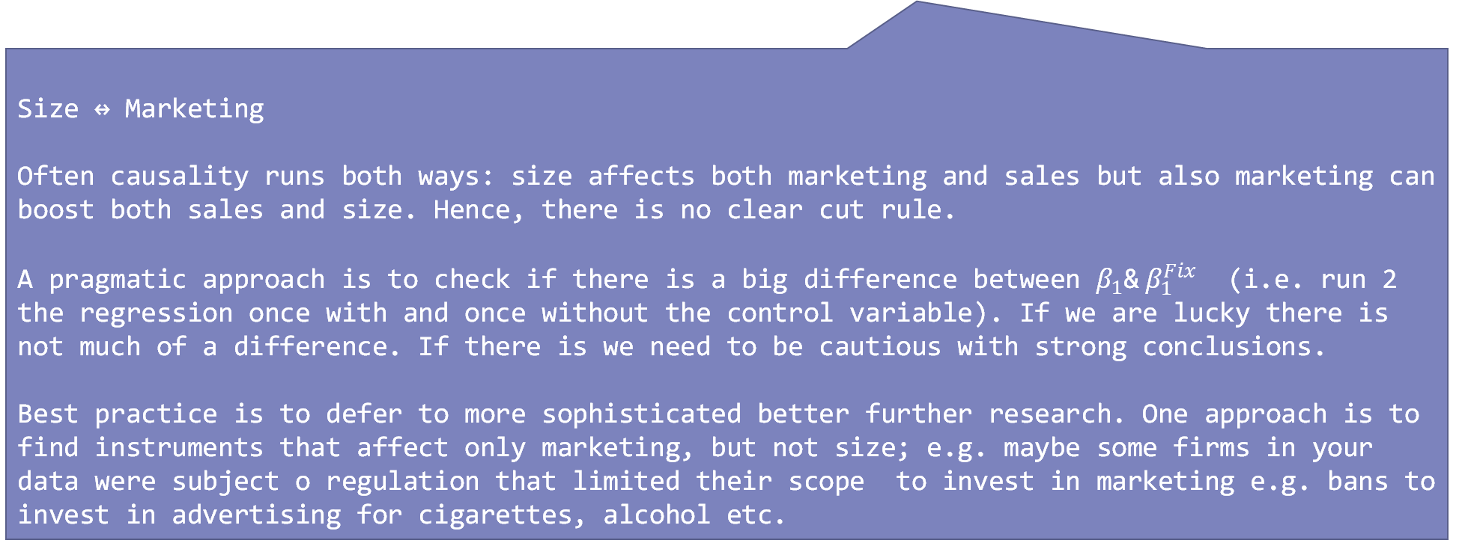
To control or not control?
$$ε$$
$$Sales=β_{0}+β_{1}^{Fix}×Marketing+β_{2}Size+η$$
Size ↔ Marketing
Often causality runs both ways: size affects both marketing and sales but also marketing can boost both sales and size. Hence, there is no clear cut rule.
A pragmatic approach is to check if there is a big difference between $β_{1}$&$β_{1}^{Fix}$ (i.e. run 2 the regression once with and once without the control variable). If we are lucky there is not much of a difference. If there is we need to be cautious with strong conclusions.
Best practice is to defer to more sophisticated better further research. One approach is to find instruments that affect only marketing, but not size; e.g. maybe some firms in your data were subject o regulation that limited their scope to invest in marketing e.g. bans to invest in advertising for cigarettes, alcohol etc.

